Slide 1
Water-related Disaster
Michele laurante
Istituto a.volta pavia

Slide 2
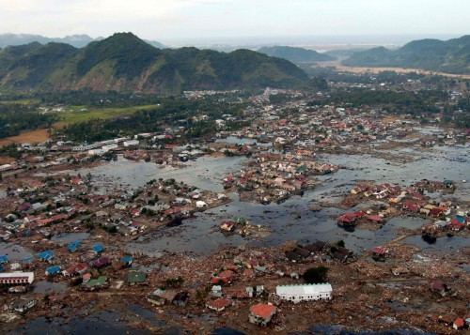
The rise of natural disasters
When disaster strikes, it usually manifests itself through water. Floods, landslides, hurricanes, tsunamis, storms, heat waves, cold spells, droughts and waterborne disease outbreaks are all becoming more frequent and more intense.
These weather and climate events can cause disruptions in health and social services, scarcities of food and water and an increase in conflict and migration. With the right tools to adapt to and mitigate adversity, communities can build resilience and continue to achieve development goals.
A ruined village near the coast of Sumatra after the 2004 tsunami.

Slide 3
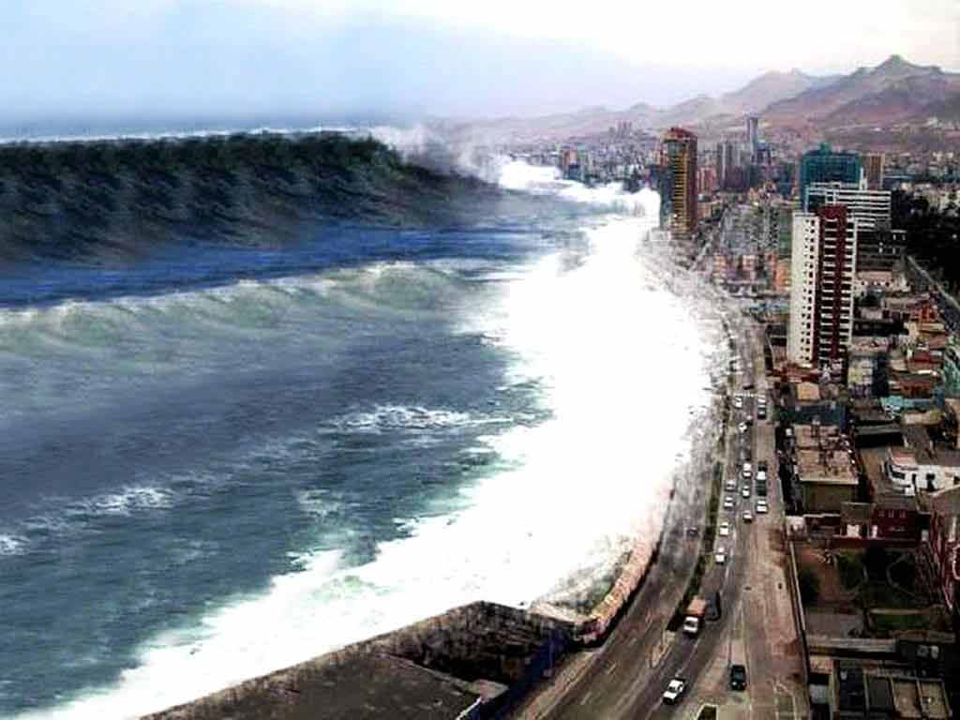
The killer wave
The 2004 Indian Ocean earthquake occurred on 26 December, with an epicentre off the west coast of northern Sumatra, Indonesia. It was an undersea megathrust earthquake that registered a magnitude of 9.1–9.3 Mw.
A series of large tsunamis up to 30 metres (100 ft) high were created by the underwater seismic activity. Communities along the surrounding coasts of the Indian Ocean were seriously affected, and the tsunamis killed an estimated 227,898 people in 14 countries. The earthquake was one of the deadliest natural disasters in recorded history

Slide 4
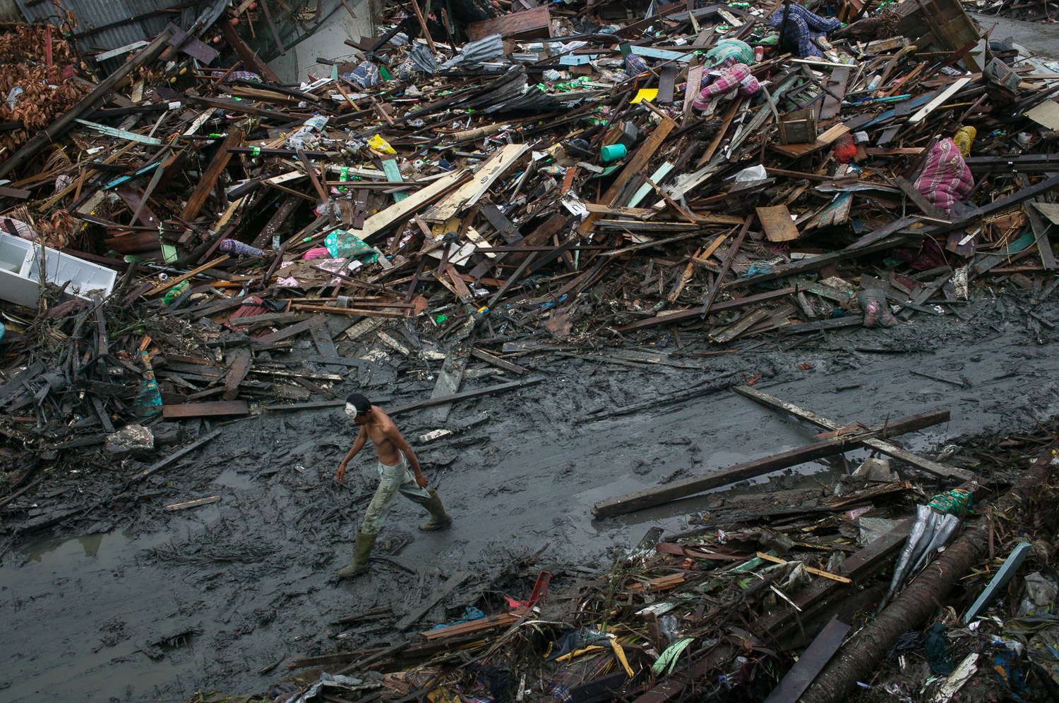
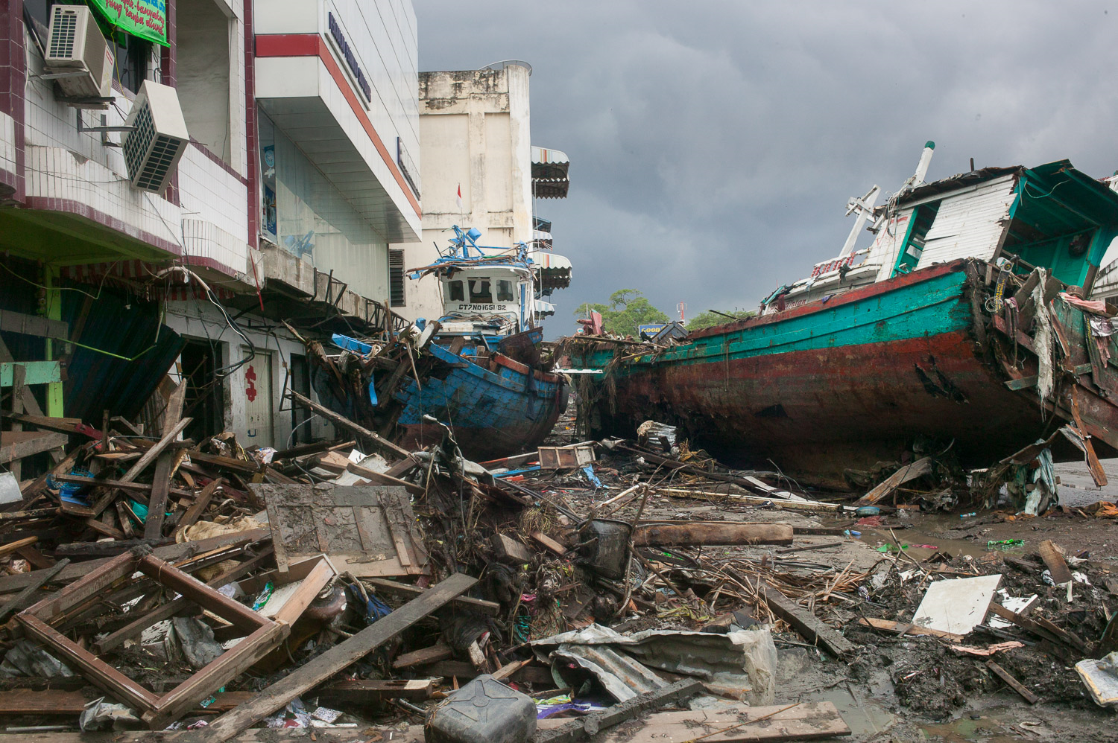
What’s left?

Slide 5
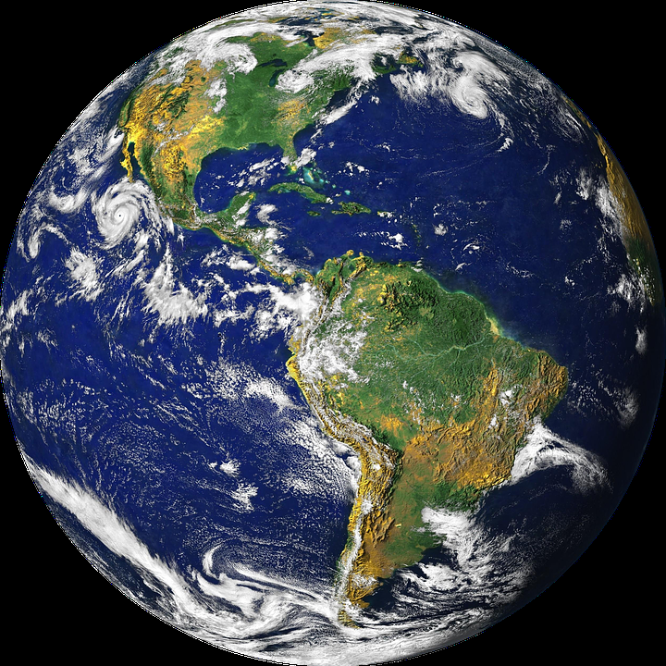
How can we stop all of this?
We can’t stop natural phenomena from happening.
But we can make them less damaging if we understand better why they happen, and what we can do to prevent or mitigate them.
Since people are partly responsible for disasters happening, we have to change what we are doing wrong, in order to avoid or reduce the impact of natural phenomena.
Every community must get to know its own features and surroundings: the natural environment as well as environment built by human beings. This is the only way for a community to manage the hazards that surround it and to reduce its own vulnerability to these hazards.

Slide 6
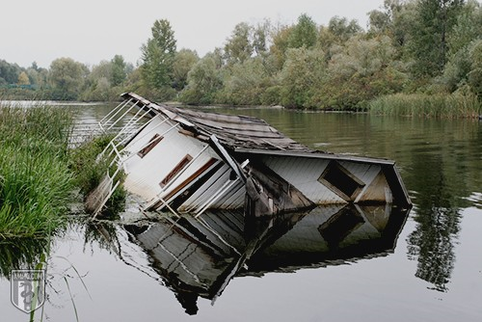
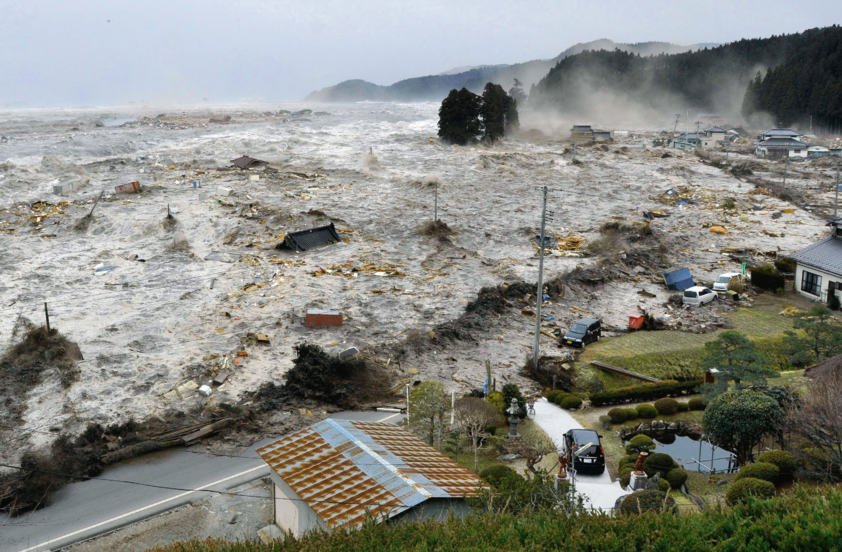
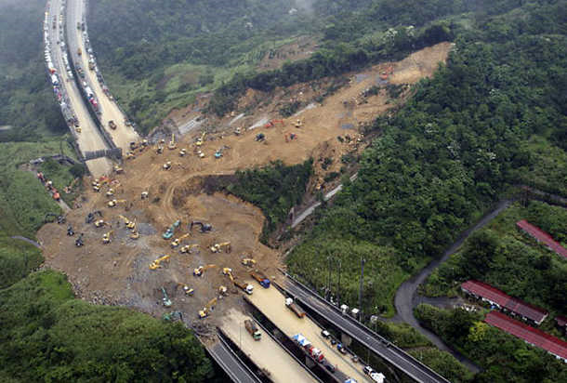
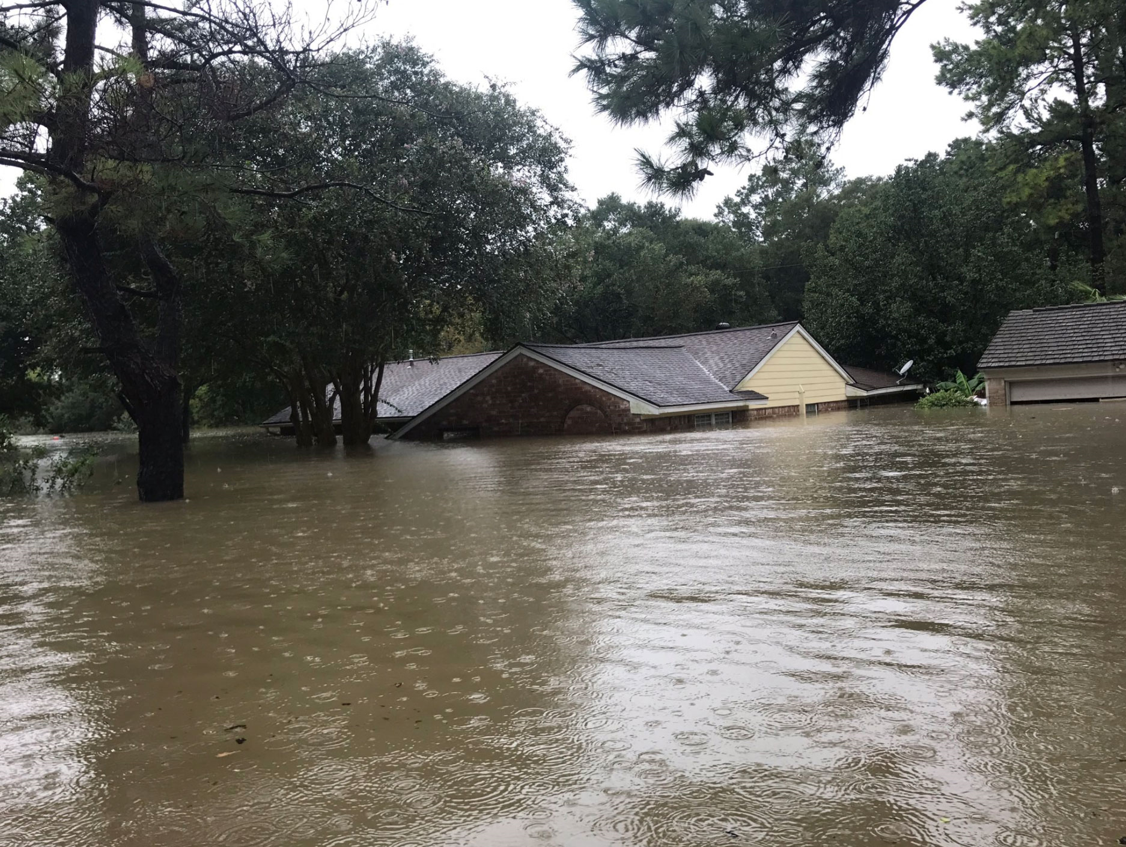
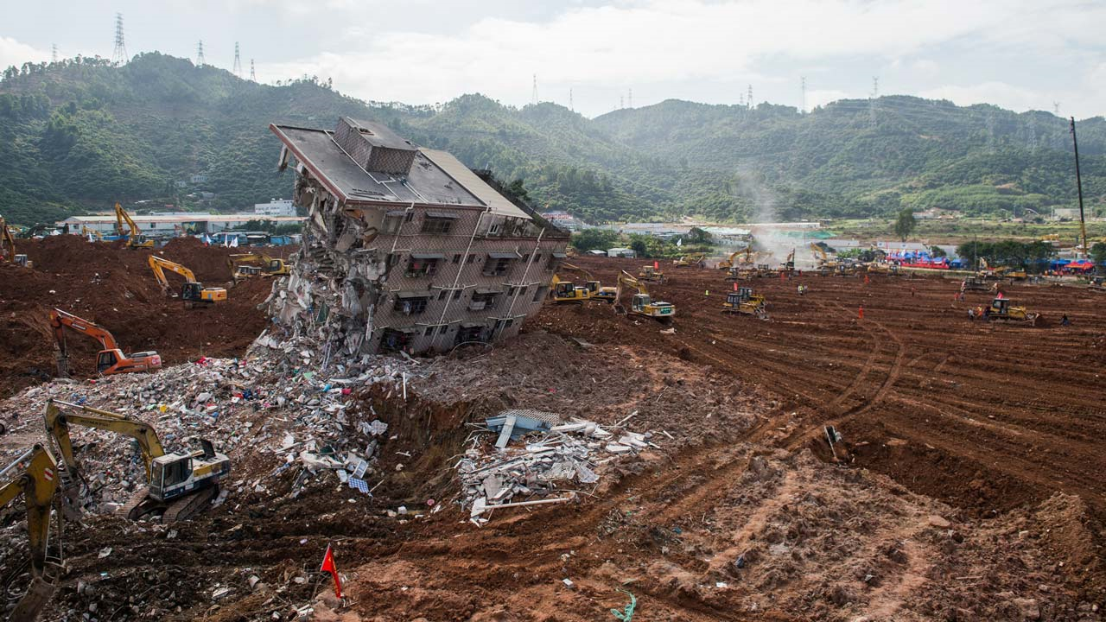
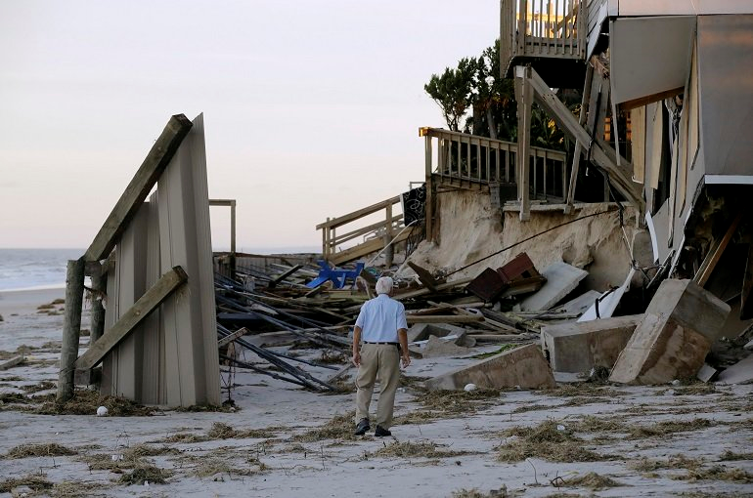
\
IT’S TIME TO CHANGE

